Slide 1
DS 5220 Final Project
Shivani Patel and Owen Davey

Slide 2

The Data Set
The Bike Sharing Data Set from the UCI Machine Learning Repository
Measures the number of bike rentals from a automated bike rental stand in a given hour
17389 instances
16 Atributes

Slide 3

Attributes
Record Index
Date
Season (1:winter, 2:spring, 3:Summer, 4:Fall)
Year
Month (1 to 12)
Hour (1 to 23)
Holiday
Weekend
Working Day
Weather
Temperature
Humidity
Windspeed
Casual rentals
Register user rentals
Count of total rentals

Slide 4

Data Cleaning
Trimmed off Index and membership information
Created a Boolean attribute to represent high rentals
Split X and Y

Slide 5
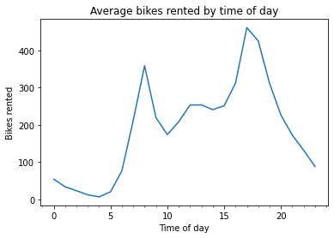
Analysis
We performed some rudimentary analysis on the data.
Here we see that during peak commuting hours our bike rentals also peak.

Slide 6
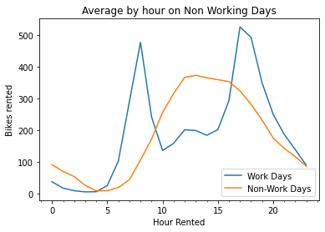
Non working days
This is a study of how rentals change when it is a standard working day (Monday-Friday) vs a standard non-working day (Weekends and Holidays).

Slide 7


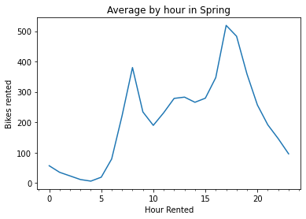

When we control for season we see
Though the actual amount of rentals at a given time fluctuates the peak hours remain the same with extremely similar shapes.

Slide 8
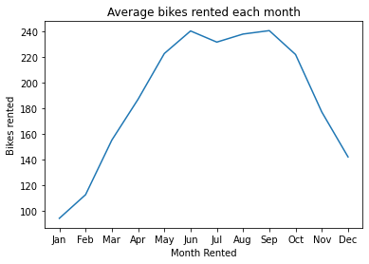
Bikes rented by month
We can see there does seem to be a strong correlation between month and rentals with the highest average hourly rentals happening in the summer months

Slide 9
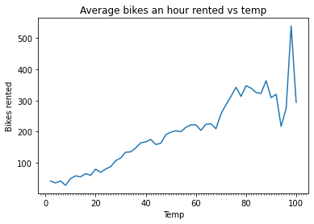
How temperature effects
Given the relationship between months and rentals we specifically explored temperature and bike rentals. The instability in the graph towards the end can be explained by having fewer data points.

Slide 10
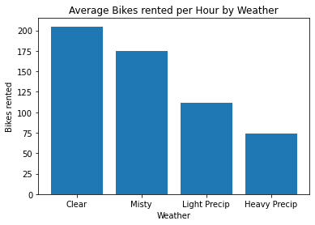
Weather
The next step was to look at how weather affects the number of bikes rented. We can see and decrease in rentals as weather gets worse

Slide 11
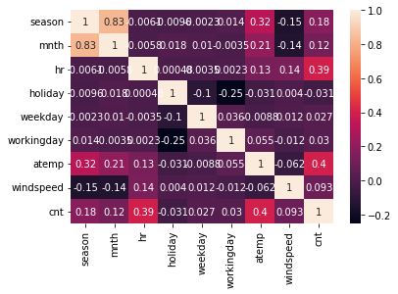
Correlation Matrix
Finally, we chose to do a correlation matrix on our data. There isn’t a strong correlation between any of the variables that isn’t obvious (season and month), which means that when predicting the number of bike rentals, looking at any individual feature will not be sufficient

Slide 12
Methodology
Random Forest Regression
Random Forest Classification
Naive Bayes
Neural Network
Logistic Regression
Ridge Regression

Slide 13
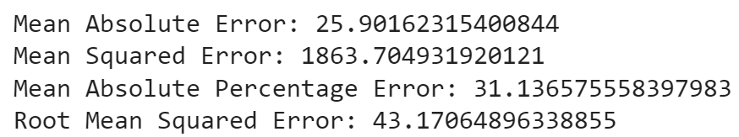

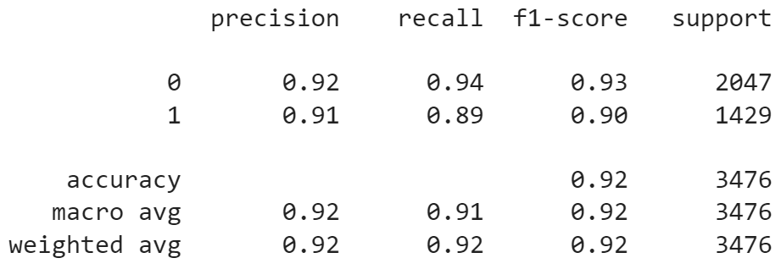
Random Forest (Regression & Classification)
Classification:
Confusion Matrix:
Classification Report:
Regression:
Accuracy Score:
0.9185845799769851

Slide 14
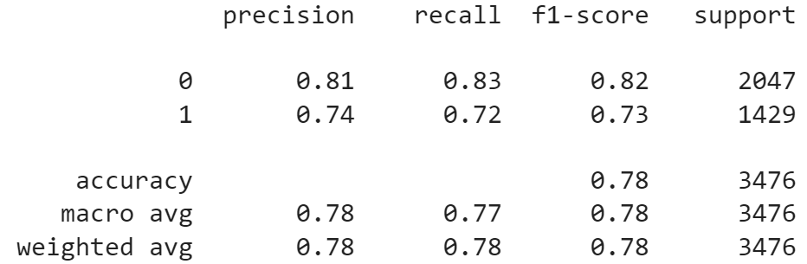
Naive Bayes
Classification Report:
Accuracy Score:
0.7839470655926352

Slide 15
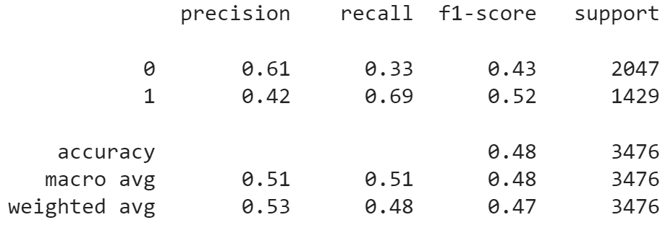
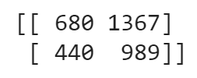
Neural Networks
Classification Report:
Confusion Matrix:
Accuracy Score:
0.48014959723820483

Slide 16
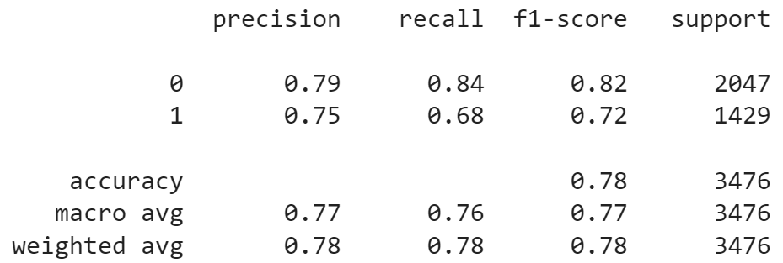

Log Regression
Classification Report:
Confusion Matrix:
Accuracy Score:
0.7773302646720368

Slide 17
Ridge Regression
Training Data:
RMSE:
141.47307170557784
R2 Score:
0.38730099774858595
Testing Data:
RMSE:
143.1306938002819
R2 Score:
0.3944740239656034

Slide 18
Results
Of all of the tried methods, random forest classification had the highest accuracy and precision scores and ridge regression had an r2 score that was lower than 0.4, making it a bad model for our data.
Future Steps: Implement K-Fold and cross validation
Take a closer look at registered vs unregistered bike rentals

